Slide 1

Particle Swarm Optimization: A First Introduction
Professor Bo Liu
James Watt School of Engineering

Slide 2
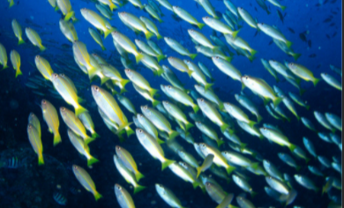
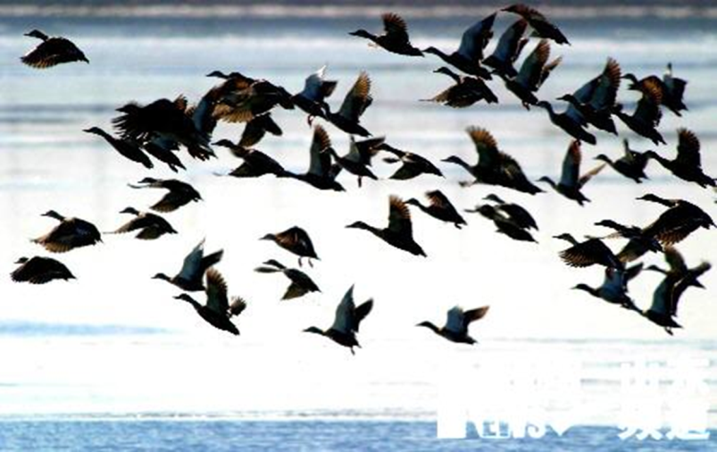
What is swarm?
Swarm can be described as a collection of interacting neighboring individuals.
Fish colony.
Bird colony.

Slide 3
The swarm intelligence
Fish gathering in a group can effectively find food.
Any fish can drive the whole fish group to the food if it finds it.
A swarm is formed by multiple individuals.
Individuals can interact with each other.
Fish feeding model

Slide 4
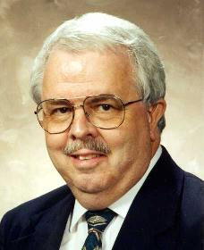
Overview of PSO
An optimization method based on swarm intelligence.
Particle swarm optimization (PSO) was proposed by Kennedy and Eberhart in 1995.
Simulates the flight and foraging behavior of birds in groups.
There are many different versions nowadays, called PSOs.
Russ Eberhart

Slide 5
Particles (Solutions)
x2
Position
Velocity
x1

Slide 6



Basic ideas of PSO
Initialized as a group of random particles (population), each having its position and velocity.
Find the optimal solutions (i.e., positions) by iterations.
Update particles by tracking two "extreme values" .
$$pBest$$
$$gBest$$
pBest is the best position (solution) of the current particle
gBest is the best position (solution) of the whole population

Slide 7
The work flow of PSO algorithms
Initialization
position, velocity
Evaluate pBest for each particle
position
Update gBest of the population
position
Compute velocity of each particle
velocity
Update each particle’s position
position
Termination conditions?
No
Yes
Output the optimal solution

Slide 8




Thanks!
#UofGWorldChangers
@UofGlasgow

